Slide 1
Clare Dinham, Michelle Bales,
Conservation Officers

Slide 2
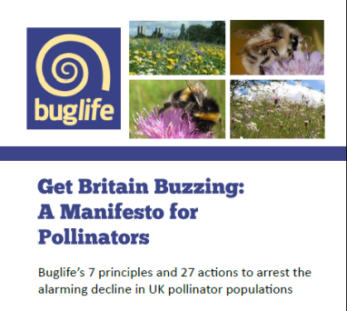
Buglife – ‘Saving the small things that run the planet’
Europe's only organisation devoted to conservation of all invertebrates
Aim to halt the extinction of invertebrates and achieve sustainable populations
Our pollinators are in trouble, we have a plan!
Notes:
We have a plan, number of projects to reach this

Slide 3
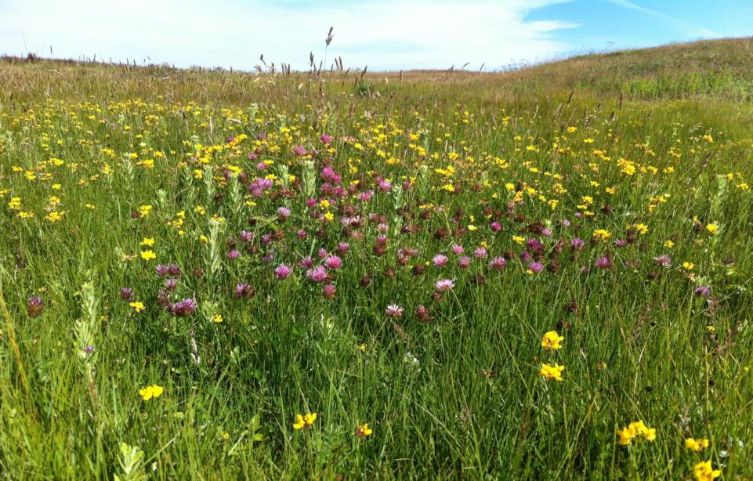
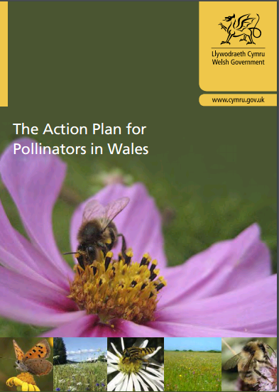

Slide 4
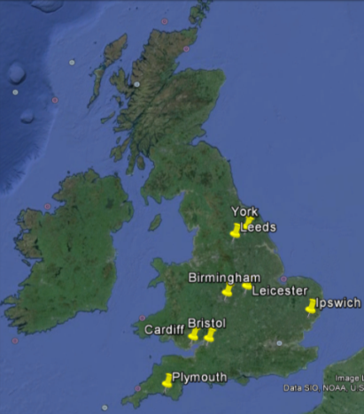
Urban Buzz - Introduction
In a nutshell…
8 cities in England and Wales
Creating pollinator habitat in these cities to inspire others to follow lead
Community lead- must suit their needs
Funders: Biffa Award, Garfield Weston Foundation, and Heritage Lottery Fund

Slide 5
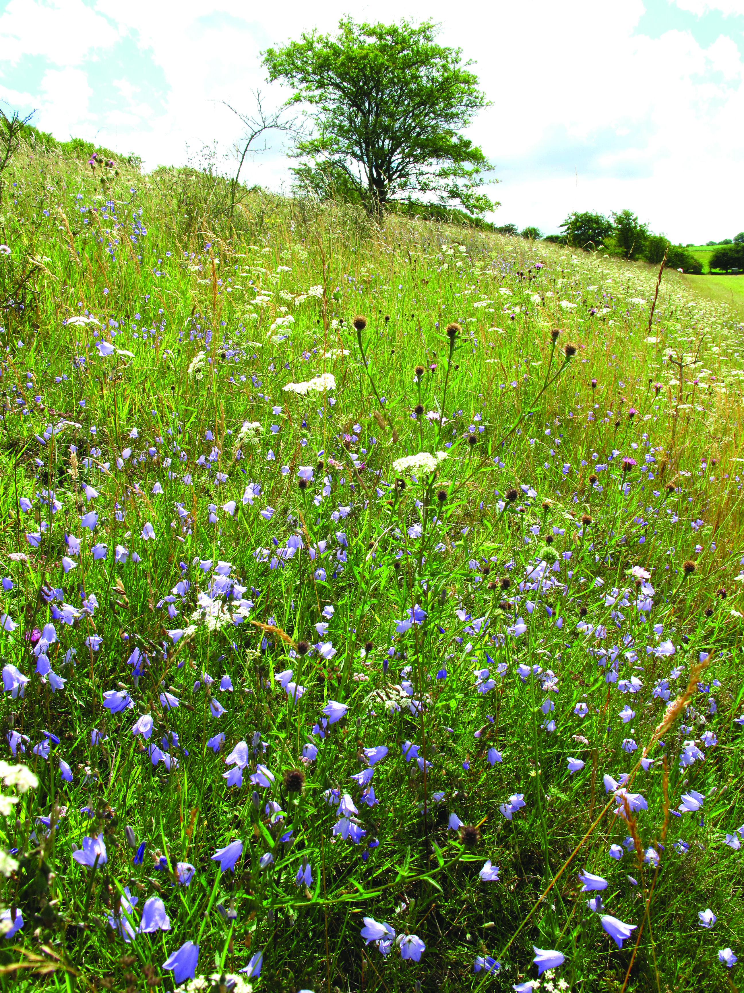
B-Lines
3km wide continuous lines of permanent wildflower-rich habitat
Link together and expand best wildlife areas by enhancing, restoring and creating new habitat
Expanding wildlife sites & stepping stones
Linking with and joining other wildlife initiatives e.g. My Wild City,
Urban Buzz
Co-ordinated and collaborative work

Slide 6
South and West Wales B-Lines

Slide 7
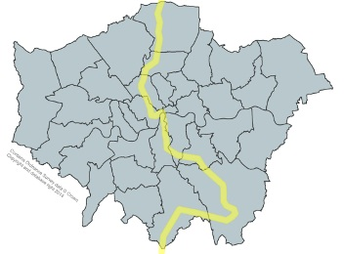
Making a B-Line for London
33% green space
14% private gardens

Slide 8
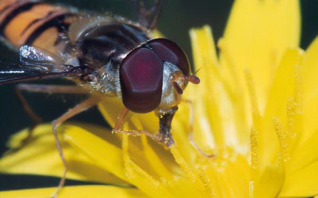
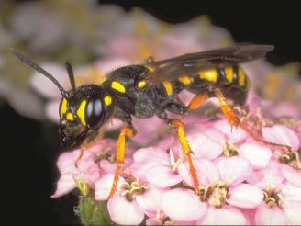
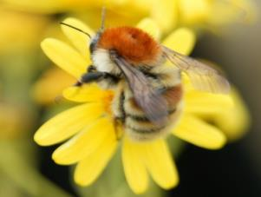
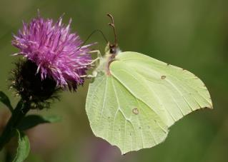
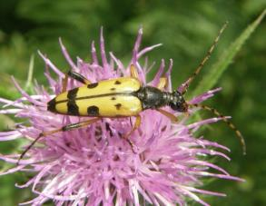
Insect pollinators

Slide 9
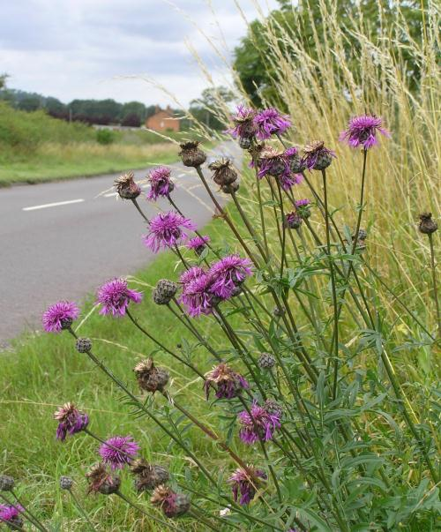
Pollinator requirements
Key considerations
Forage resource
Nesting
Shelter and Over-wintering habitat
Variety of habitats
Urban - managing peoples perceptions…

Slide 10
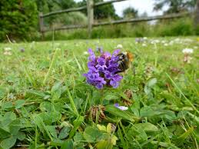
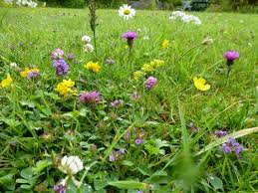
Opportunities within public green space
Alternative to amenity grassland where greenspace must be kept short
Self-heal, Cowslip, Red clover, Bedstraws, Bird’s-foot trefoil, Ox-eye daisy, Buttercups, dead nettles
Can withstand a more frequent mowing regime

Slide 11
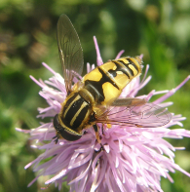
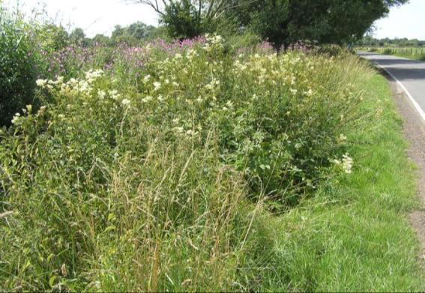
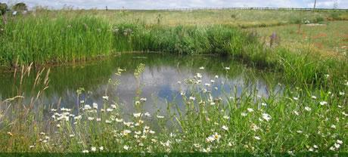
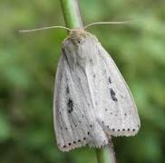
Ditches and Ponds
Hoverfly (Helophilus pendulus)
Can provide valuable nesting and forage habitat
Allow some uncut vegetation to remain at all times
Wainscots

Slide 12
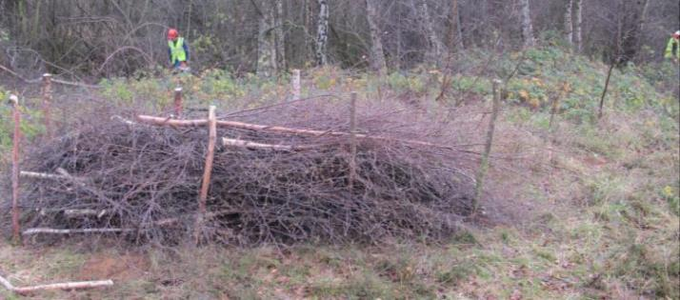
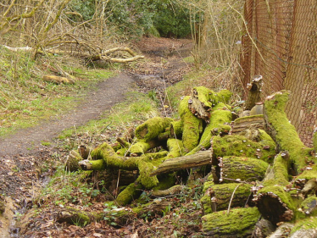
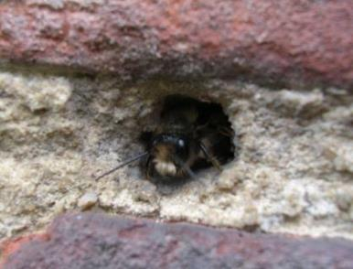
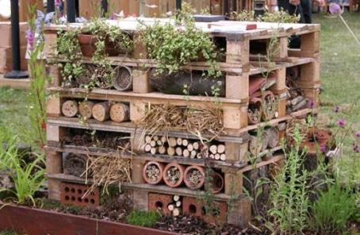
Give a bee a home

Slide 13
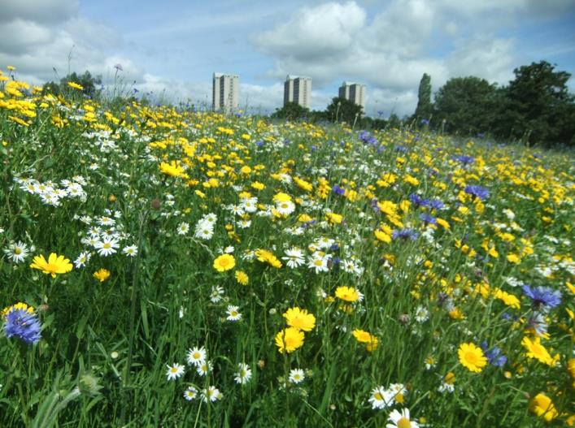
Examples

Slide 14
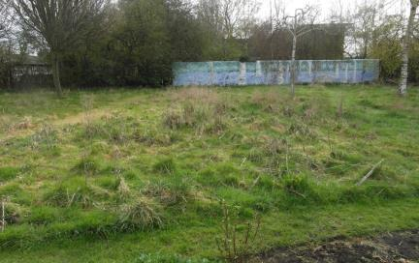
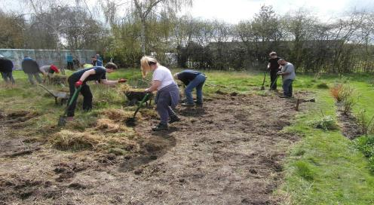
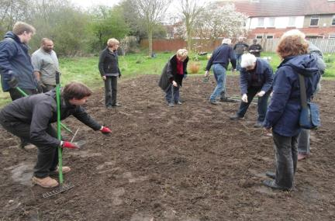
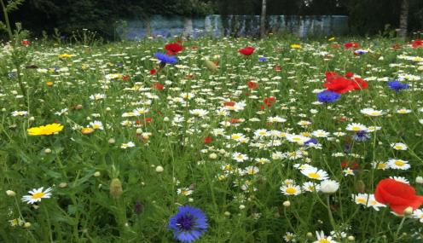
Planting in Parks
Community involved
Notes:
Picture from the P drive

Slide 15
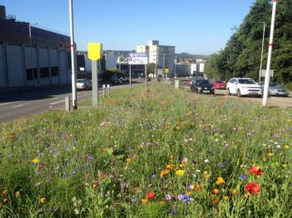
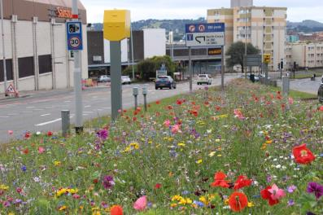
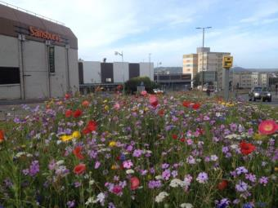
Long flowering season

Slide 16
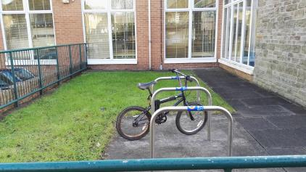
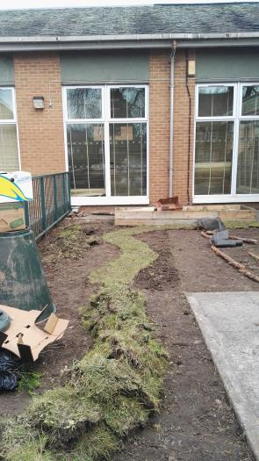
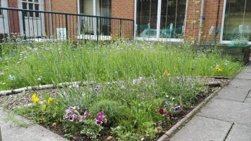
Small scale- Stepping Stones

Slide 17
Cemeteries as schools green space
Enhancing sites

Slide 18
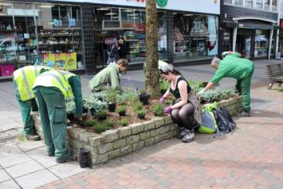
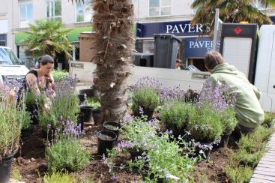
Urban Planting in city centres
High profile
Very urban
Low maintenance

Slide 19
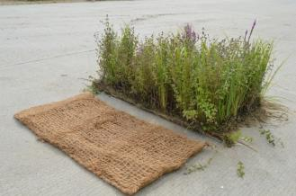
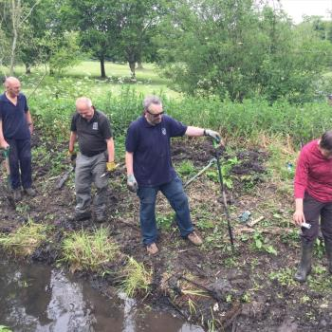
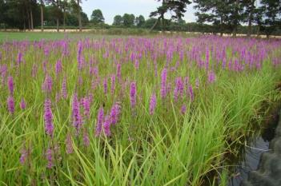
Multi purpose
Coir mats-
Reduce river erosion and increase forage for pollinators

Slide 20
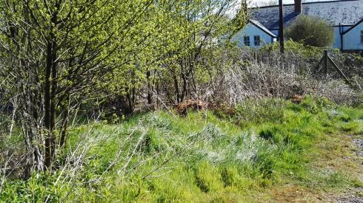
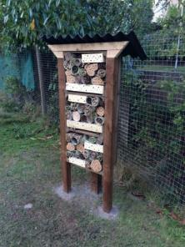
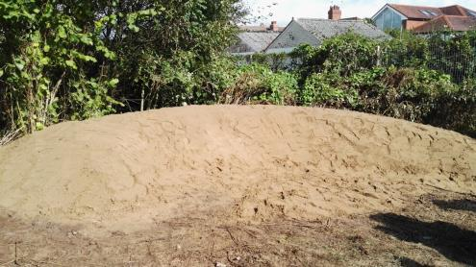
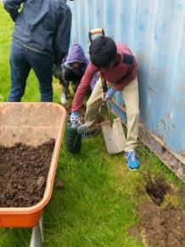
Nesting sites
Bee banks
Bug hotels
Scrub/ hedging/ hollow stemmed plants

Slide 21
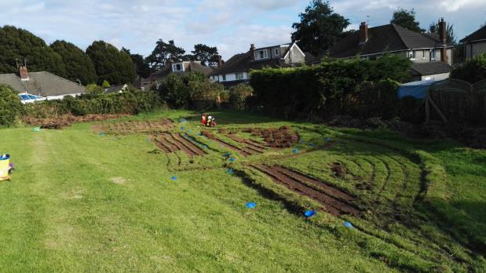
Multiple habitats
Bee bank
Meadow
Scrape

Slide 22
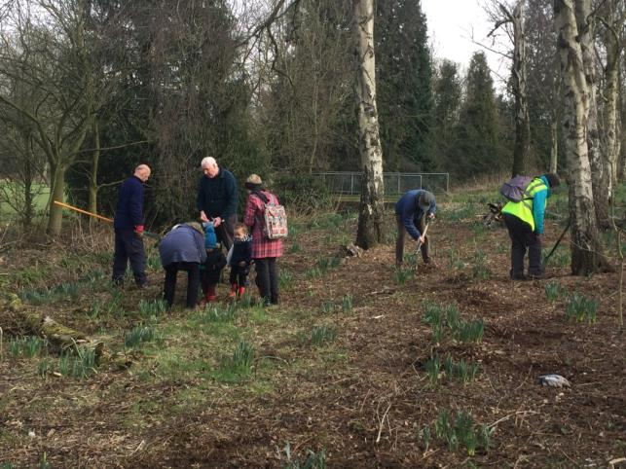
Woodland
In Cardiff-
Targeted planted for White letter hairstreak

Slide 23
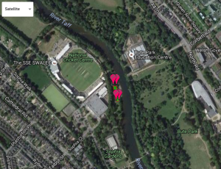
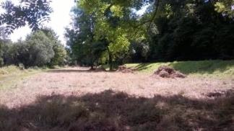
Management plans

Slide 24
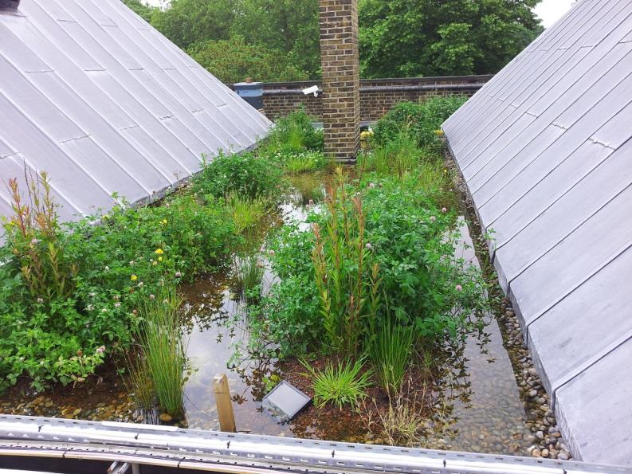
Green roofs

Slide 25
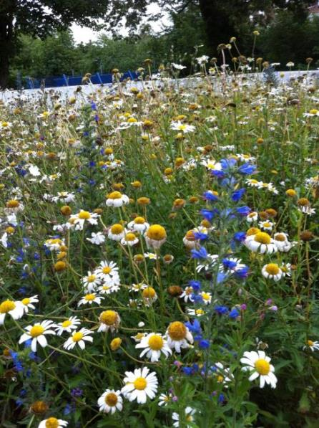
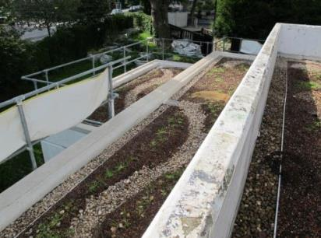
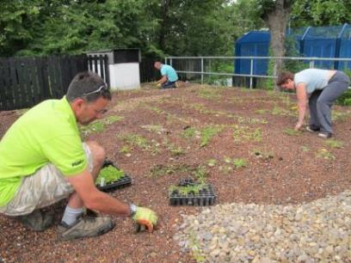
Green roofs

Slide 26
Green roofs

Slide 27
Urban Buzz- Green roofs
Bute park green roof
Small scale on shed roofs

Slide 28
Green roofs

Slide 30
Clare.dinham@buglife.org.uk
Michelle.bales@buglife.org.uk
www.buglife.org.uk Tel: 07464 828 626 @buzz_dont_tweet
Buglife is a registered charity at Bug House, Ham Lane, Orton Waterville, Peterborough, PE2 5UU
Registered Charity No: 1092293, Scottish Charity No: SC040004, Company No: 4132695

